Slide 1
In-house Secure Translation – Overview
Translation approach based on Machine Learning – NLP concept
Oversættelsesmetode baseret på Machine Learning - NLP koncept
Solution Highlights:
Works on a pre-trained NLP Transformer model
Provides state-of-the-art translation quality, comparable to Google translation
Completely self-contained solution without dependency on internet – no issue of data privacy
Coded in Python, so we have complete control over user data storage and transmission outside our system boundaries
Possibilities:
Possible to deploy this functionality on say, an Ubuntu instance in AWS and expose as a webservice
No other cost than deployment / hosting
The Nordic multi-lingual translation can also be achieved with similar approach
Limitation:
The only disadvantage currently is the computational response time, which ranges from 11-15 seconds
Højdepunkter for løsning:
Arbejder på en forududdannet NLP Transformer model
Giver state-of-the-art oversættelse kvalitet, kan sammenlignes med Google oversættelse
Helt selvstændig løsning uden afhængighed af internettet - ingen spørgsmål om data privatliv
Kodet i Python, så vi har fuldstændig kontrol over brugerens datalagring og transmission uden for vores systemgrænser
Muligheder:
Mulighed for at implementere denne funktionalitet på sige, en Ubuntu instans i AWS og udsætte som en webservice
Ingen andre omkostninger end implementering / hosting
Nordens flersprogede oversættelse kan også opnås på denne måde
Begrænsning:
Den eneste ulempe i øjeblikket er den beregningsmæssige responstid, som spænder fra 11-15 sekunder
Bemærk: Over oversættelse af løsningstilgangen opnås ved hjælp af det interne sikre oversættelsesværktøj

Slide 2
In-house Secure Translation – Quality Comparison
No. | Danish | English – Transformer solution | English – Google translation
1 | hvordan har du det i dag? | How are you today? | how are you today?
2 | Jeg vil have et tilbud fra dig. | I want an offer from you. | I want an offer from you.
3 | Din ordre kan ikke behandles, fordi den har 14 fejl, der kræver manuel korrektion. | Your order cannot be processed because it has 14 errors that require manual correction. | Your order cannot be processed because it has 14 errors that require manual correction.
4 | Der er ændring på hvilken sti (path), som skal anvendes, når fællesdrevet tilgås. Du skal fremover bruge den sti, som står i kolonne ”D” i vedlagte. | There is a change on which path (path) to use when accessing the common drive. In the future, use the path in column "D" of the attached. | There is a change in which path is to be used when accessing the common drive. In future, you must use the path that is in column "D" in the attached.
5 | Der er i weekenden gennemført ændring på nedenstående fællesdrev (file shares). Ændringen er ved en fejl ikke blevet kommunikeret ordentligt. | There has been a change on the common drive (file shares) below this weekend. The change has not been communicated properly by mistake. | This weekend, a change was made to the following common drives (file shares). The change has not been communicated properly by mistake.

Slide 3
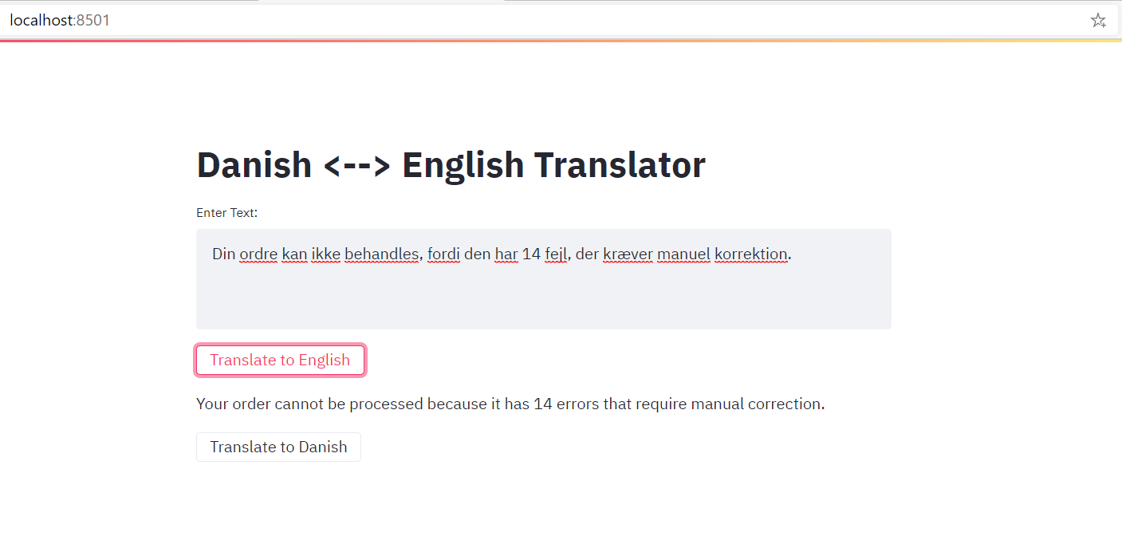
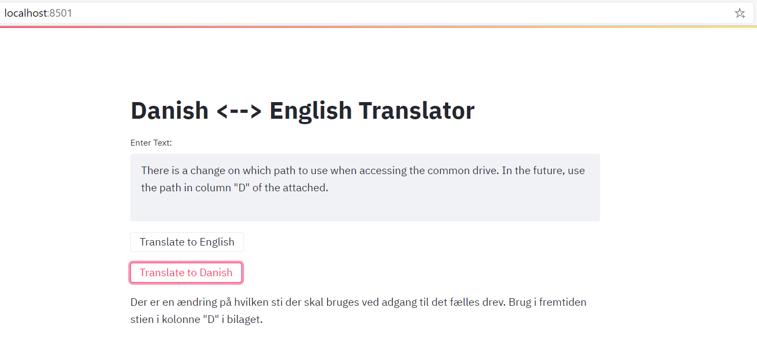
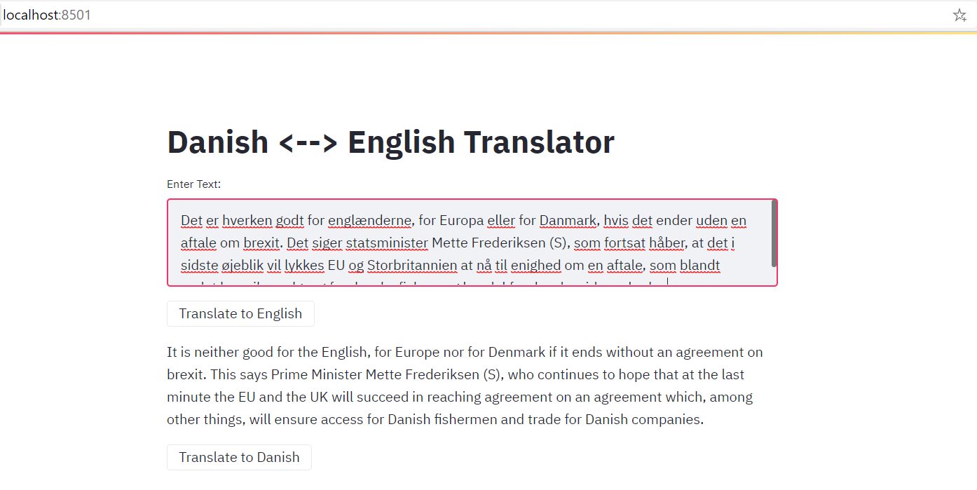
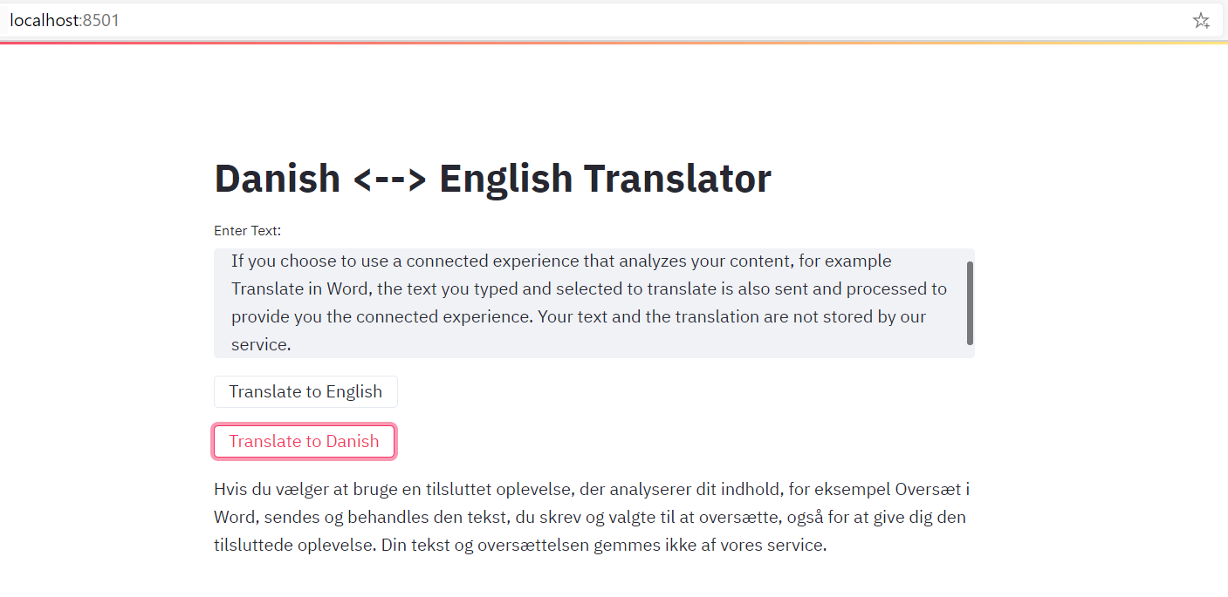
In-house Secure Translation - Demo

Slide 4
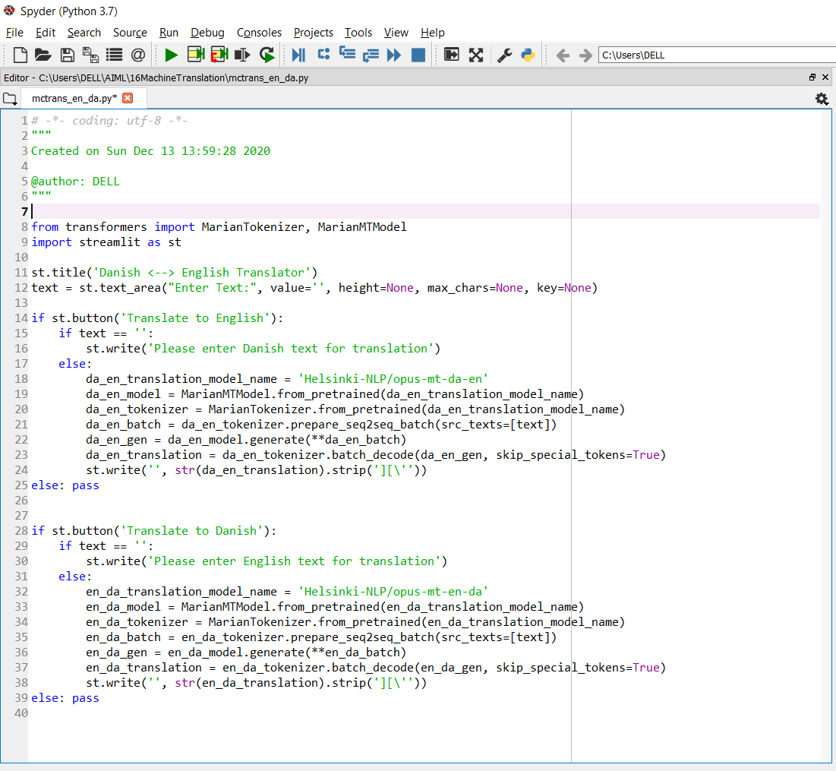
In-house Secure Translation – Code Control
40 lines of code
Simple & transparent implementation
Full control of the data
Can be enhanced for multi-lingual translation

